Slide 1

PRESENTED BY- ADITYA KUMAR
UNIVERSITY ROLL NO – 34230821034
SUBJECT NAME- COMPUTER ORGANIZATION
SUBJECT CODE- PCC-CS302
ADDIDTION AND SUBTRACTION OF FIXED POINT NUMBER SYSTEM
FUTURE INSTITUTE OF TECHNOLOGY
Dept.-COMPUTER SCIENCE ENGINEERING(AI&ML)

Slide 2
WHAT IS
FIXED POINT REPRESENTATION?
Every positive integer, including zero, can be represented by an unsigned manner, but a negative number has to be represented with a minus sign at the front.
But due to the hardware limitations, computer must represent everything with ones and zeros including the sign of a number.
as a consequence it is customary to represent the sign with a bit placed in the left most position of the number.
The convention is to make the sign bit equal to 0 for positive and to 1 for negative.

Slide 3
INTEGER REPRESENTATION:
When an integer binary number is positive, the sign bit is represented by 0 and the magnitude by a positive Binary number. When the number is negative, the sign bit is represented by 1 but the rest of the number may be represented by any of the three possible ways:
SIGNED-MAGNITUDE REPRESENTATION
SIGNED-1’s COMPLEMENT REPRESENTATION
SIGNED-2’s COMPLEMENT REPRESENTATION
The sign-magnitude representation of a negative number consists of the magnitude and the negative sign. But, in the other two representations , the negative number is represented by either the one’s or the two's complement of it’s positive value.

Slide 4
-12 IN SIGNED 1’S COMPLIMENT:
+12 IN NORMAL REPRESENTATION
1 1 1 1 0 0 1 1
0 0 0 0 1 1 0 0
REPRESENTATION OF +12 & -12 IN THE PREVIOUSLY MENTIONED INTEGER REPRESENTATIONS:
-12 IN SIGNED 2’S COMPLIMENT:
-12 IN SIGNED MAGNITUDE REPRESENTATION:
1 1 1 1 0 1 0 0
1 0 0 0 1 1 0 0

Slide 5
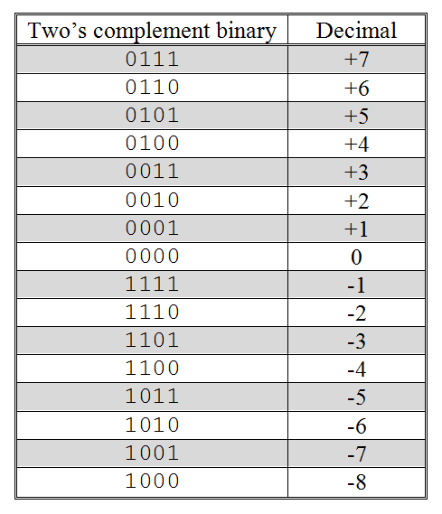
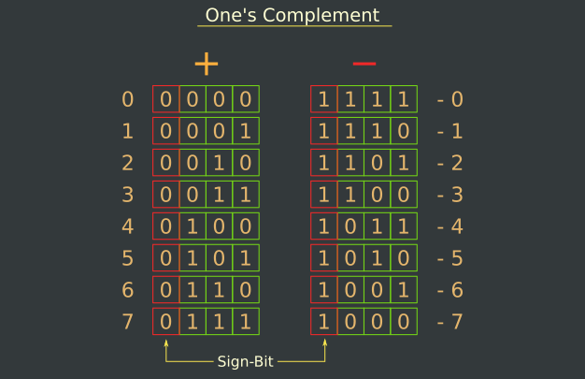
2’s COMPLEMENT BINARY:
1’s COMPLEMENT BINARY:

Slide 6
The primary advantage of two's complement over one's complement is that two's complement only has one value for zero. One's complement has a "positive" zero and a "negative" zero.
Next, to add numbers using one's complement we have to first do binary addition, then add in an end-around carry value. Two's complement has only one value for zero, and doesn't require carry values.
ADVANTAGE OF 2'S COMPLEMENT OVER 1'S COMPLEMENT:

Slide 7
ARITHMETIC ADDIDTION:
SIGNED MAGNITUDE SYSTEM:
The addition of two numbers in the sign-magnitude system follows the rule of ordinary arithmetic. If the sign are the same, we add the two magnitude and give the sum, the common sign. If the signs are different, we subtract the smaller magnitude from the larger and give the result the sign of the larger magnitude. [EXAMPLE: (+15)+(-25)= -10] This process required, the comparison of the sign and the magnitude and then performing either additions or subtraction
SIGNED-1’s COMPLEMENT REPRESENTATION:
Case I: When the positive number has greater magnitude.
In this case addition of numbers is performed after taking 1’s complement of the negative number and the end-around carry of the sum is added to the least significant bit.
Case II: When the negative number has greater magnitude.
In this case the addition is carried in the same way as in case 1 but there will be non end-around carry. The sum is obtained by taking 1’s complement of the magnitude bits of the result and it will be negative.

Slide 8
SIGNED-1’s COMPLEMENT REPRESENTATION examples:
Case 1 example:
+ 0111 and - 0011
Solution:
+ 0 1 1 1 ⇒ 0 1 1 1 - 0 0 1 1 ⇒ 1 1 0 0 (taking 1’s complement) 1 1 1 0 0 + 1 carry 0 1 0 0
Hence the required sum is + 0100.
Case 2 example:
+ 0011 and - 0111
Solution: + 0 0 1 1 ⇒ 0 0 1 1 - 0 1 1 1 ⇒ 1 0 0 0 (1’s complement) 1 0 1 1 Hence the required sum is – 1011.

Slide 9
SIGNED- 2’s COMPLEMENT REPRESENTATION:
The rule for adding numbers in the signed 2's complement system does not require a comparison or subtraction only addition and complementation is required. The procedure is very simple and can be stated as follows:
-Add the two numbers, including their sign bits and discard any carry out of the sign (leftmost) bit position . Negative number must initially be in two's complement and that if the sum obtained after the addition is negative, it is in two's complement form.
-We use 2’s complement for binary representation of negative numbers

Slide 10
The procedure to perform subtraction is given below:
In the first step, find the 2's complement of the subtrahend.
Add the complement number with the minuend.
If we get the carry by adding both the numbers, then we discard this carry and the result is positive else take 2's complement of the result which will be negative.
ARITHMETIC SUBTRACTION:

Slide 11
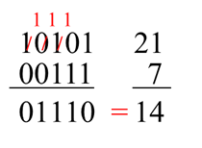
Example 1: 10101 - 00111
We take 2's complement of subtrahend 00111, which is 11001. Now, sum them. So,
10101+11001 =1 01110.
In the above result, we get the carry bit 1. So we discard this carry bit and remaining is the final result and a positive number.
Example 2: 10101 - 10111 We take 2's complement of subtrahend 10111, which comes out 01001. Now, we add both of the numbers. So,
10101+01001 =11110.
In the above result, we didn't get the carry bit. So calculate the 2's complement of the result, i.e., 00010. It is the negative number and the final answer.

Slide 12
THANK YOU

